Slide 1
Homework
Week 5

Slide 2
Question 1
Helen has 24 red apples and 12 green apples. What fraction of the apples are green?
ANSWER = B

Slide 3
Question 2
Which number is the largest?
0.3 0.05 0.006 0.123
ANSWER = A

Slide 4
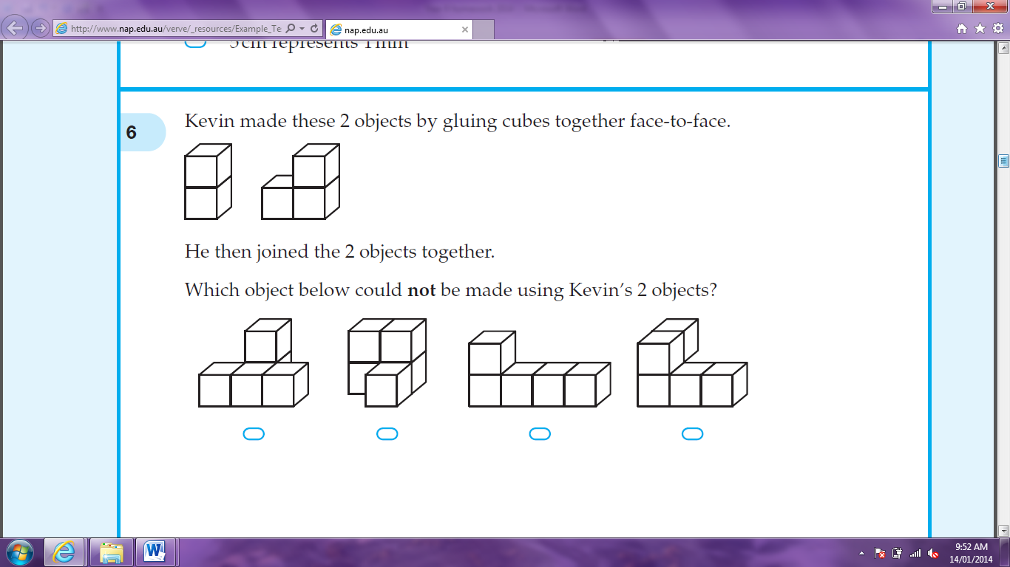
Question 3
Kevin made these 2 objects by gluing cubes together face-to-face.
ANSWER = A

Slide 5
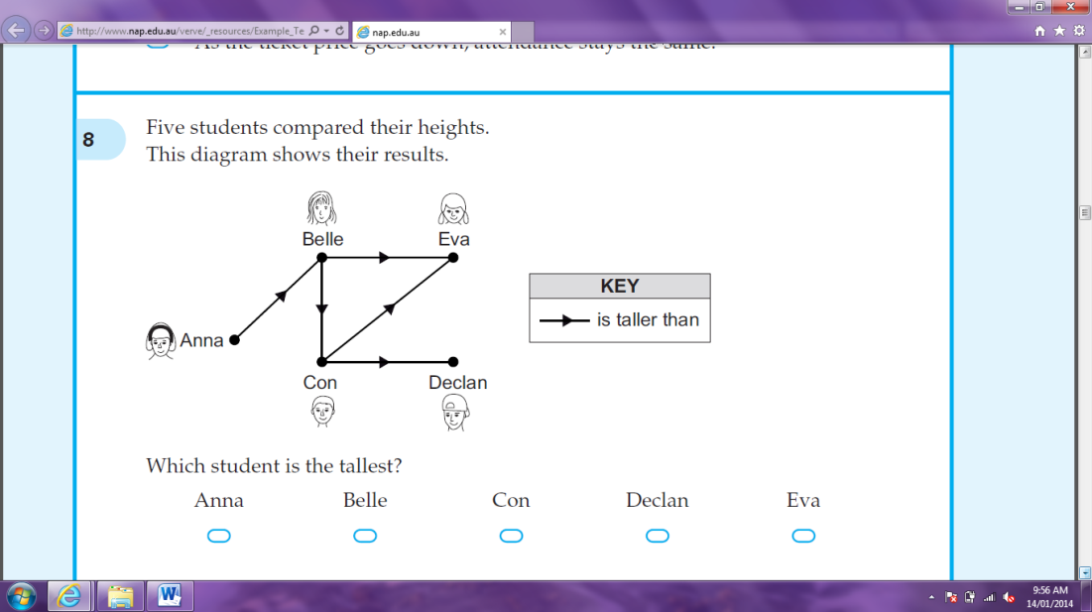
Question 4
Five students compared their heights. The diagram below shows their results. Which student is the tallest?
Anna is taller than Belle
Belle is taller thank Eva and Con
Con is taller than Eva and Declan
ANSWER = Anna

Slide 6
Question 5
Write 5 cents as a faction of a dollar, in simplest form.
ANSWER =

Slide 7
Question 6
Which is equivalent to 3t + 2t + 4t?
9t 24t 9t³ 24t³
3t + 2t + 4t = 9t
ANSWER = A

Slide 8
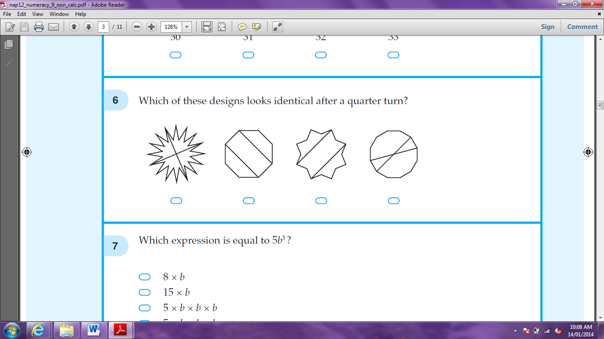
Question 7
Which of these designs looks identical after a quarter turn?
ANSWER = A

Slide 9
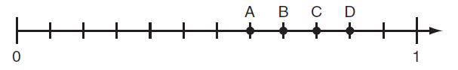
Question 8
Which position is closest to on this number line?
Answer = B

Slide 10
Question 9
What is 12 ÷ ?
Answer = 24

Slide 11

Question 10
For which object is the sum of the number of edges and number of vertices three times the number of faces?
triangular prism triangular pyramid rectangular prism rectangular pyramid
Answer = Triangular Prism
 | Sum of Edges and Vertices | Number of Faces | 3 x Number of Faces
Triangular Prism | 9 + 6 = 15 | 5 | 3 x 5 = 15
Triangular Pyramid | 6 + 4 = 10 | 4 | 4 x 3 = 12
Rectangular Prism | 12 + 8 = 20 | 6 | 6 x 3 = 18
Rectangular Pyramid | 8 + 5 = 13 | 5 | 5 x 3 = 15

Slide 12
Question 11
Terry bought 7 boxes of pencils. In total this was 84 pencils. Which equation correctly shows n as the average number of pencils?
84 x 7 = n 84 – 7 = n n ÷ 7 = 84 n x 7 = 84
Answer = D

Slide 13
Question 12
A plane arrived in Hobart at 1:20pm after hour flight from Brisbane. What time did it leave Brisbane?
1:20pm – 3 hours = 10:20am
10:20am – 45min = 9:35am
ANSWER = 9:35 am

Slide 14
Question 13
Jade buys a 500 gram bag of beads at a market. Each bead has a mass of 0.48 grams. Which is the best estimate for the number of beads in the 500 gram bag?
100 250 1000 2500
500 ÷ 0.48 ≈ 500 ÷ 0.5
= 1000
Answer = C

Slide 15
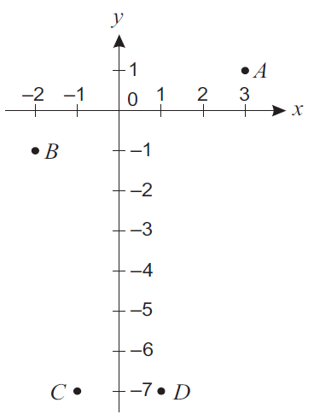
Question 14
The graph of y = 2x - 5 will be drawn on the grid below. Which two points will the straight line pass through?
A: 1 = 2 x 3 – 5
1 = 6 – 5
1 = 1 
B: -1 = 2 x -2 – 5
-1 = -4 – 5
-1 = -9 
C: -7 = 2 x -1 – 5
-7 = -2 – 5
-7 = -7 
D: -7 = 2 x 1 – 5
-7 = 2 – 5
-7 = -3 
Answer = A and C

Slide 16
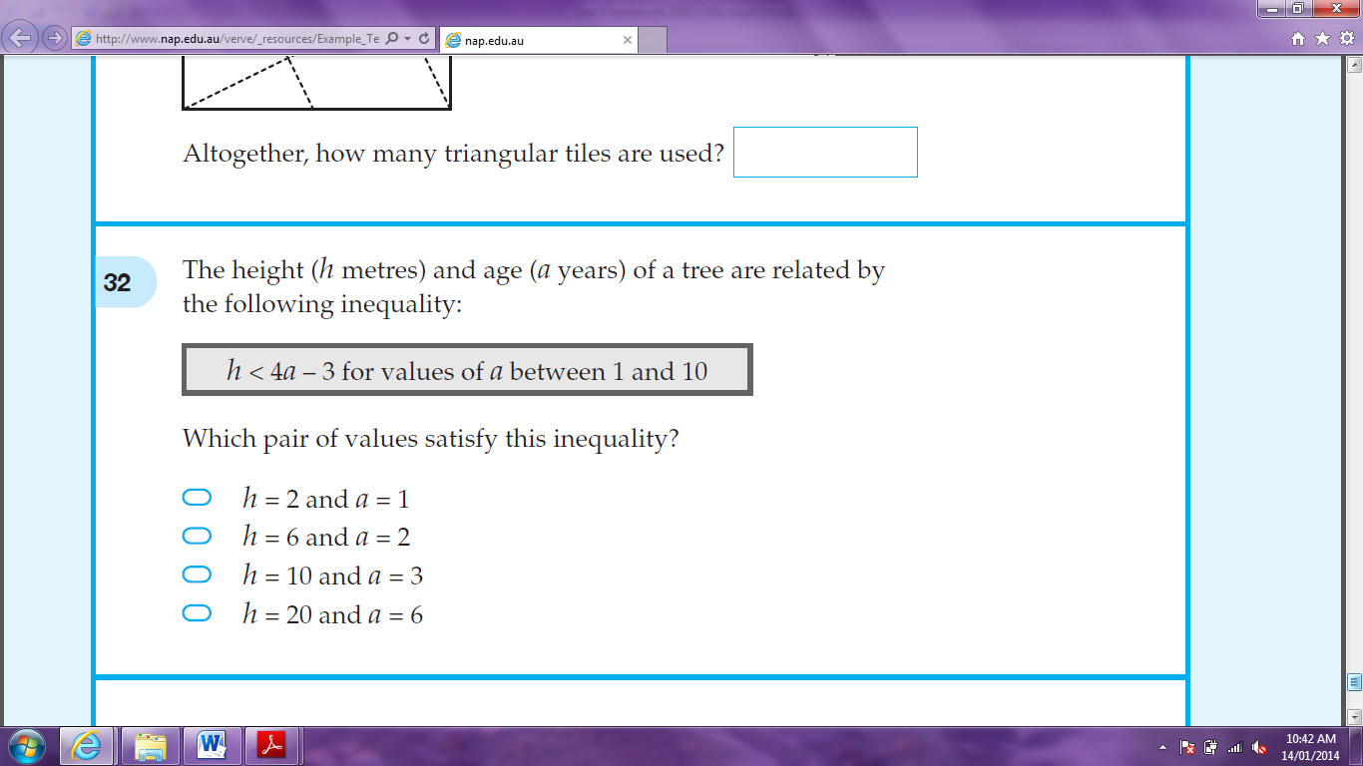
Question 15
The height (h metres) and age (a years) of a tree are related by the following inequality:
Which pair of values satisfy this inequality?
h = 2 and a = 1 h = 6 and a = 2 h = 10 and a = 3 h = 20 and a = 6
2 < 4 x 1 – 3 6 < 4 x 2 – 3 10 < 4 x 3 – 3 20 < 4 x 6 -3
2 < 1  6 < 5  10 < 9  20 < 21 
Answer = D

Slide 17
Question 16
If k = -3, what is the value of k² – 4k?
k² – 4k = (-3)² – 4 x -3
= 9 + 12
= 21
ANSWER = 21

Slide 18
Question 17
Which expression is equivalent to 3(1 – p) – p?
3(1 – p) – p = 3 – 3p – p
= 3 – 4p
Answer = C

Slide 19
Question 18
7f + 8 = 5f – 4. What is the value of f?
7f + 8 = 5f – 4 (

